Slide 1
[ 자폐아동의 사회성발달 학습용 프로그램 개발 ]
Notes:
////
Hello, I'm Nayoung Choi of Team D.
Now I will start our mid-term presentation.

Slide 2
Index
Progress Timeline / Team member Role
DB
UI
Server
Next Week Plan
Notes:
///
This is the Index of today’s presentation.
First of all, I will show you the progress timeline and the role of each team member.
Then, I will explain what we worked on DB, front end, and server.

Slide 3
Progress Timeline (Front-end)
 | content | week
 |  | 1-4 | 5 | 6 | 7 | 8 | 9 | 10 | 11 | 12 | 13 | 14 | 15
Front | UI / UX
Notes:
///
To start with the front-end plan,
we will continue to revise the program based on survey feedback from parents of autistic children,
so the program of fianl version is likely to be completed around week 14.
☆☆☆☆
There are several naver cafes for parents and therapist of autistic children.
Our team is planning to conduct a survey mainly
at 거북맘토끼맘 카페, which has 270,000 members.

Slide 4
Progress Timeline (Back-end)
 | content | week
 |  | 1-4 | 5 | 6 | 7 | 8 | 9 | 10 | 11 | 12 | 13 | 14 | 15
Back | server
 | DB
Notes:
///
Likewise, server and DB operations may require modification based on survey feedback,
so we have set a long working period.

Slide 5
Progress Timeline (AI/etc)
content | week
 | 1-4 | 5 | 6 | 7 | 8 | 9 | 10 | 11 | 12 | 13 | 14 | 15
AI model / dataset
Survey / revise / review
Notes:
///
ai model dataset is currently only ready for the emotion dataset, and the object dataset is not ready yet.
And our team is considering adding a character recognition function/
to compensate for the small number of classes in the fruit dataset.
Lastly, a survey of parents of autistic children will be conducted from about three weeks later,
and the program will be revised and supplemented based on the survey.

Slide 6
Team member Role
UI/UX
로그인/ 회원가입 DB
서버 구축 기획
서버 프로토타입 구현
ai model dataset
김지원
김세연
이종우, 김용택
이종우
최나영
Notes:
///
And I'll tell you about the parts that each team member is working on.
Jiwon is mainly in charge of the front end,
Seyeon is in charge of the Database,
Jongwoo and Yongtaek are in charge of the server,
and finally, I am in charge of the AI data set.

Slide 7

DB
Notes:
///
Then, I will explain what our team worked on DB from now on.
First, i will tell you the difference
between server side programming and client side programming.

Slide 8
DB 연동
Server-side programming (php, java, node.js)
direct access to DB
Better security and performance
PHP
DB
Notes:
///
Server-side programming is responsible for connecting to the database and executing queries or retrieving data.
Examples of server-side programming languages include PHP, Java and node.js.
It can access directly to DB and has better security and performance.

Slide 9
DB 연동
Client-side programming (js)
Indirect access to DB
Better usability and interactivity
JS
PHP script
DB
Notes:
//
Client-side programming is typically not responsible for connecting to the database directly,
but rather making requests to the server for data, which the server-side code then receives from the database.
Examples of client-side programming languages include HTML, CSS, and JavaScript.
It access indirectly to database but has better usability and interactivity.

Slide 10


We used php and MySQL for backend DB connection
Notes:
//
we chose php and mysql for backend db connection.
Beacuse php and mysql are both widely used and have a large community of developers
so we can have a lot of community support.
In addition, both languages are relatively easy to learn and use
For beginners.
PHP MYSQL 선정이유
php is a server-side scripting language that has been around since 1994
so it can be considered an old language in web development.
HOWEVER
1. Popularity and community support:
PHP and MySQL are both widely used and have a large community of developers so we can have a lot of community support.
2. PHP is a relatively easy language to learn and use, even for beginners.
It has a simple and intuitive syntax, and there are many libraries and frameworks available that can help you get started quickly.
MySQL is also easy to use, especially for small to medium-sized databases.

Slide 11
Id Password conditions (signup.php)
Id | Password
Only English More than 6 characters | Only Enligh More than 8 characters At least 2 special characters included
Notes:
//
The following simple conditions have been added to the ID and password creation.
The ID must be at least 6 characters long and can only be English characters.
Password must be at least 8 characters long and can only be English characters.
And it must contain at least two special characters.

Slide 12
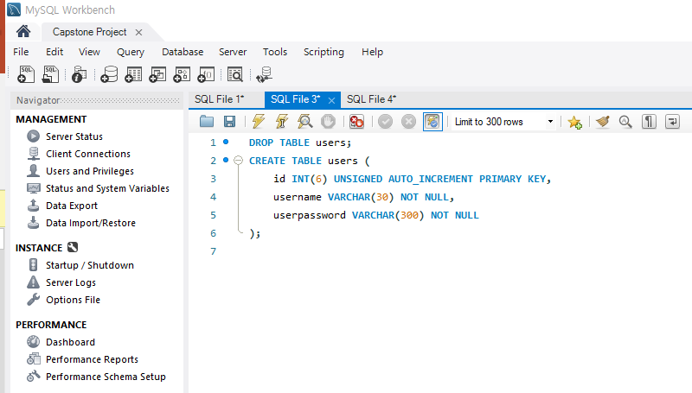
Mysql DB 및 테이블 생성
Notes:
//
We created a user information table as follows.
“id“ is defined as "UNSIGNED AUTO_INCREMENT PRIMARY KEY" and "username" is defined as VARCHAR (30).
"userpassword" is VARCHAR (300) to handle "hashing" for security purpose.
참고
해싱에는 php의 아래 함수를 사용했습니다.
password_hash() : create a new password hash using a strong one-way hashing algorithm.
해싱 후에 비밀번호가 암호화되어 더 길어져 저렇게 300처럼 길게 잡아준다고합니다.

Slide 13
로그인/회원가입 DB 연동
DB
회원가입 정보 입력
로그인
아이디 비밀번호 DB 저장
DB 등록 정보 확인 후 로그인
Notes:
//
In conclusion, we connected the DB and we can save the information in the DB for “sign-up”
and check the information when “log-in”, saving the user information ultimately.

Slide 14

Front End

Slide 15
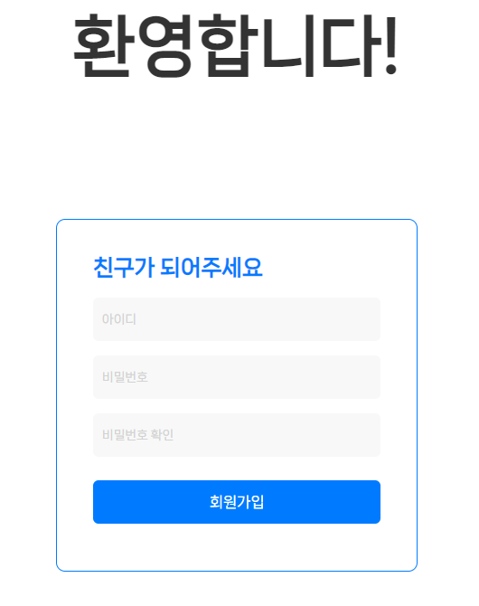
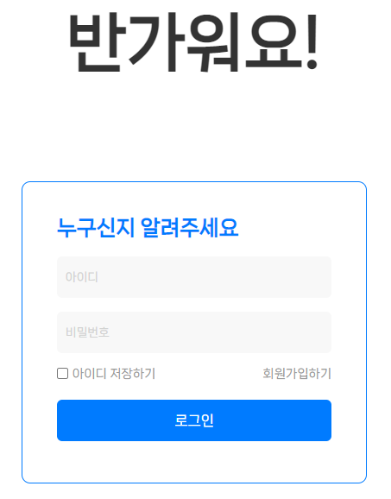

Slide 16
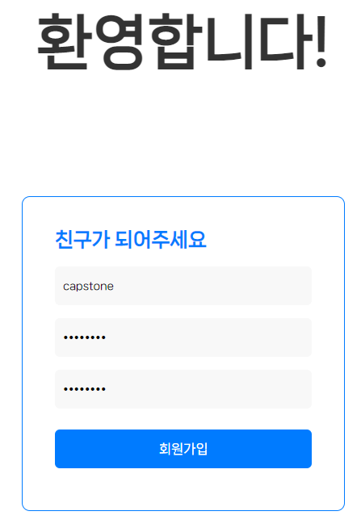
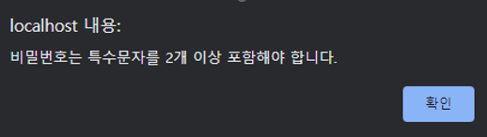
ID : capstone
PW : capstone
Not including 2 special characters

Slide 17
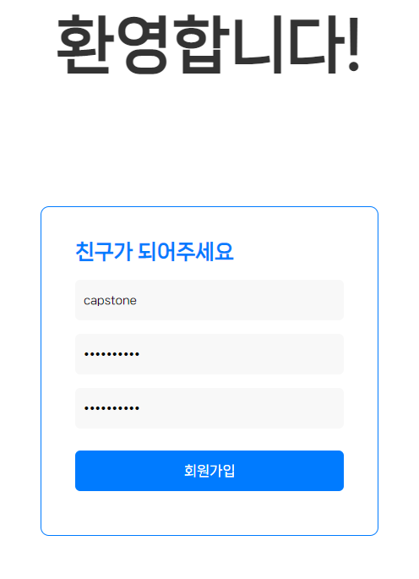
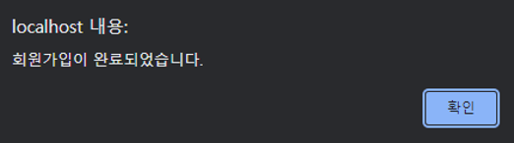
ID : capstone
PW : capstone??
Now we go

Slide 18
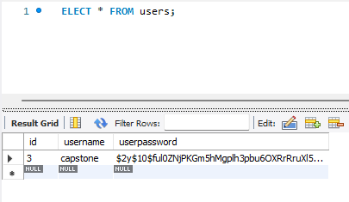
ID and hashed password stored in DB

Slide 19
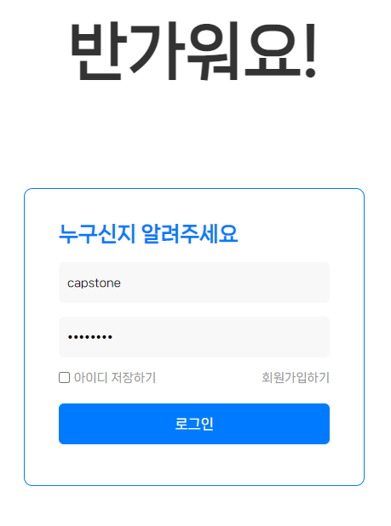
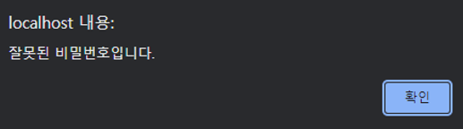
ID : capstone
Password : capstone
WRONG DATA TESTING

Slide 20
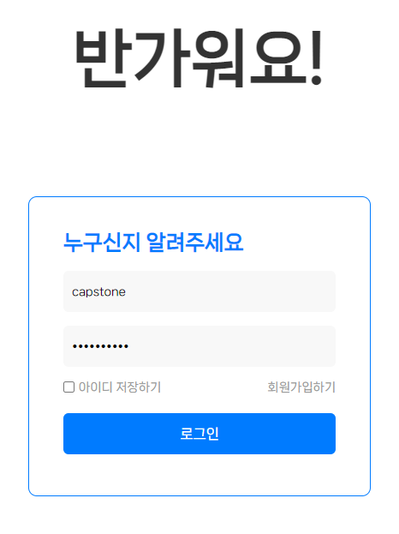
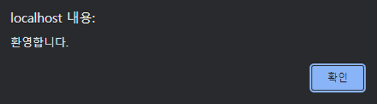
ID : capstone
Password : capstone??
CORRECT DATA

Slide 21
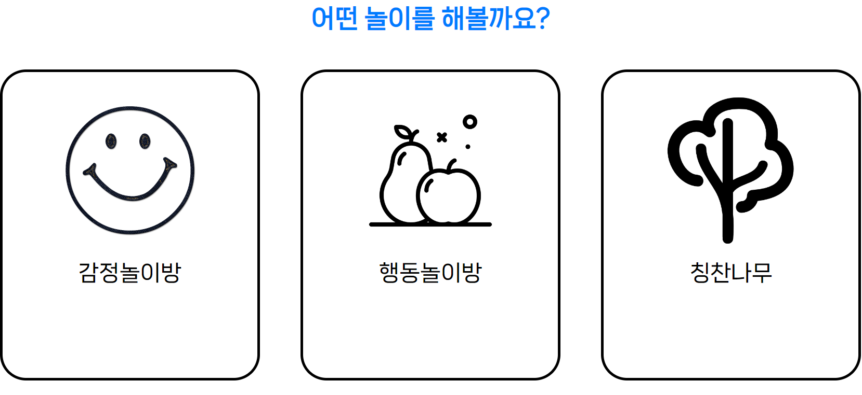

Slide 22
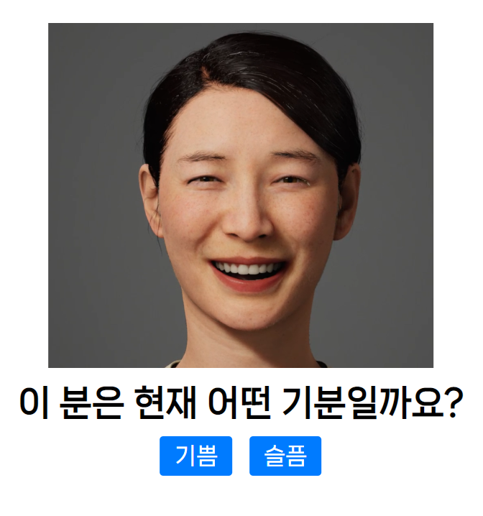


Slide 23

Back End

Slide 24

Application
Object detection
Emotion recognition
Notes:
Our main application is object detection and emotion recognition. We use Yolov8 for this.

Slide 25
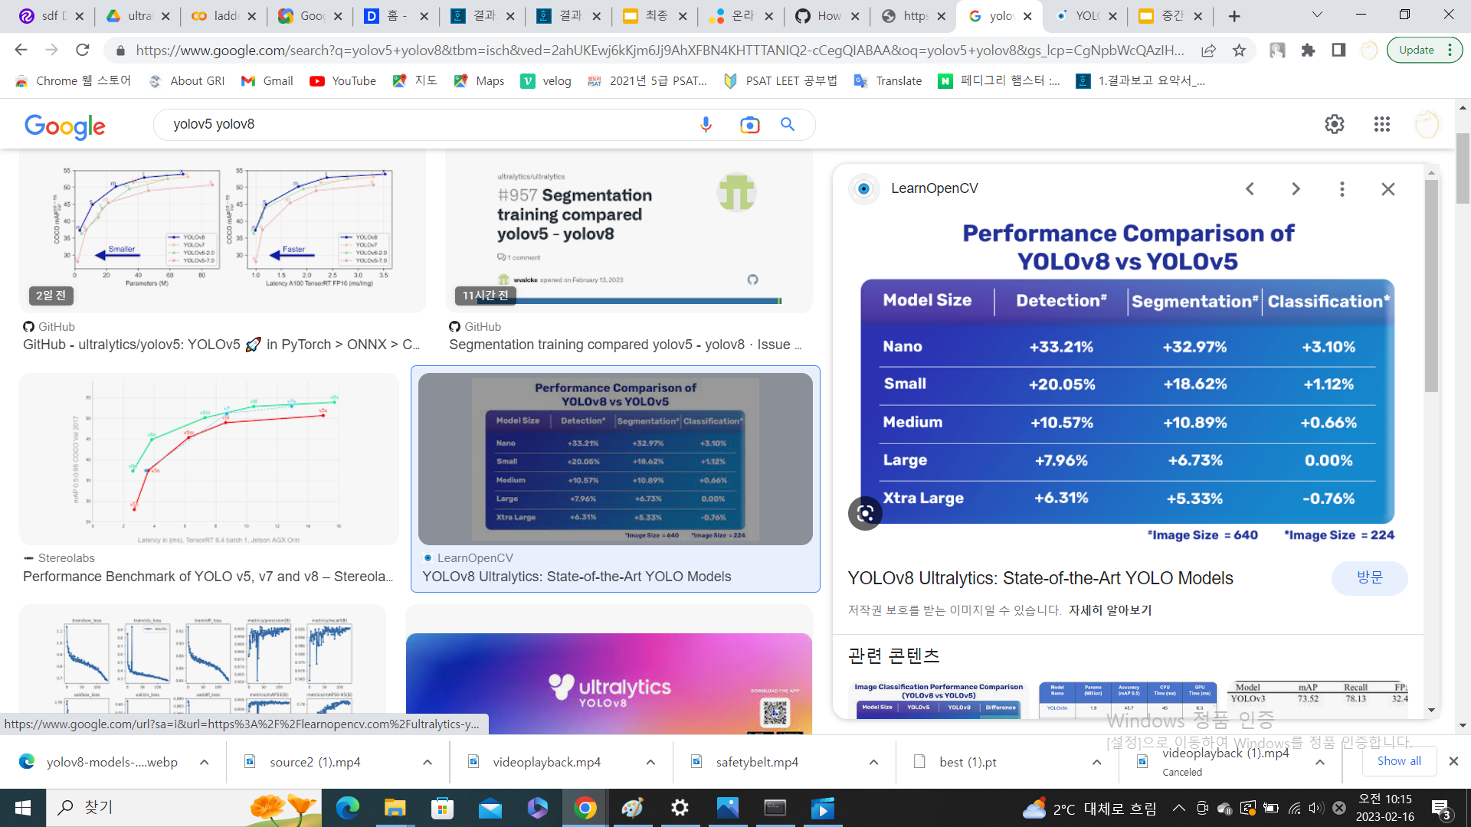
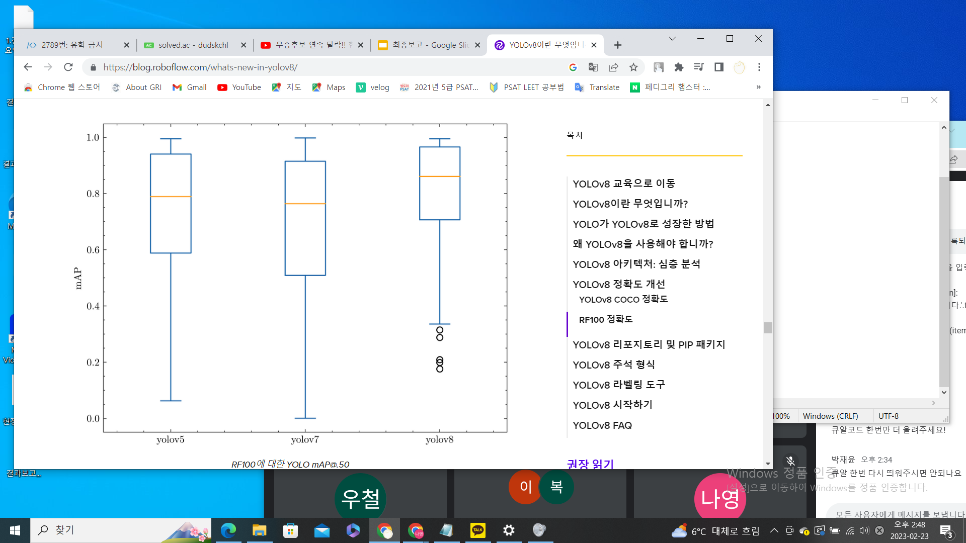
Yolov8
SOTA model of YOLO
Fast & Light
Using bind box & class
Notes:
Yolo is one of the object recognition deep learning models. Yolo is often used for real-time object recognition because of its high speed and high accuracy by using bind box and class
. And Tolov8 is SOTA model of Yolo.

Slide 26




Prototype on local
Front
Back
Notes:
This is overview of our prototype application. We run python on local and render it to front by flask. Application receives the video from the webcam and feeds it into the object recognition model to get the result.

Slide 27
Flask
Micro web framework
Route for URL
Rendering for HTML
Run app on local host
Python Framework
Notes:
Flask is a lightweight Python framework for web applications that provides the basics for URL routing and page rendering. Flask is called a "micro" framework because it doesn’t directly provide features like form validation, database abstraction, authentication, and so on. Such features are instead provided by third-party libraries

Slide 28
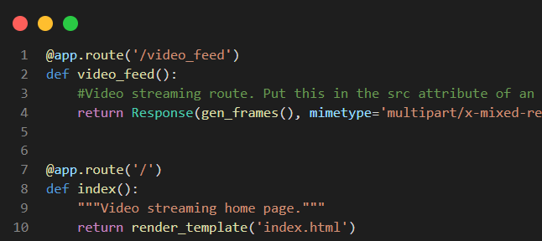
Flask – Route & Render
Route for @app.route()
Render for return render_template()
Notes:
Route is a method of processing URL paths in Flask. The route links the URL path to the function. For example, @app.route (‘/video_feed') defines a function that handles incoming requests in the video_feed path. This function returns video stream by frames. Rendering is the way Flask uses HTML templates to create dynamic web pages. Use the render_template() function to render HTML templates in Flask. This function accepts template file names and variables as arguments.

Slide 29
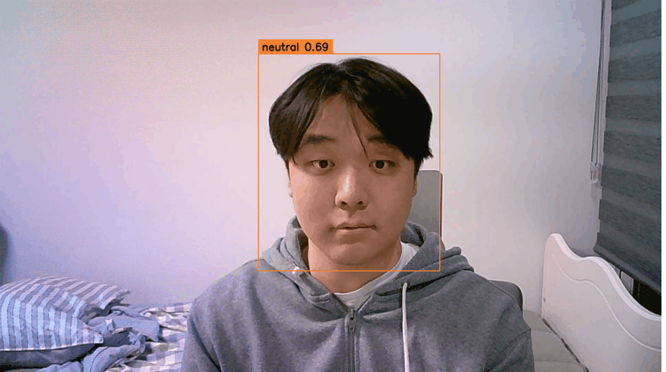

Slide 30
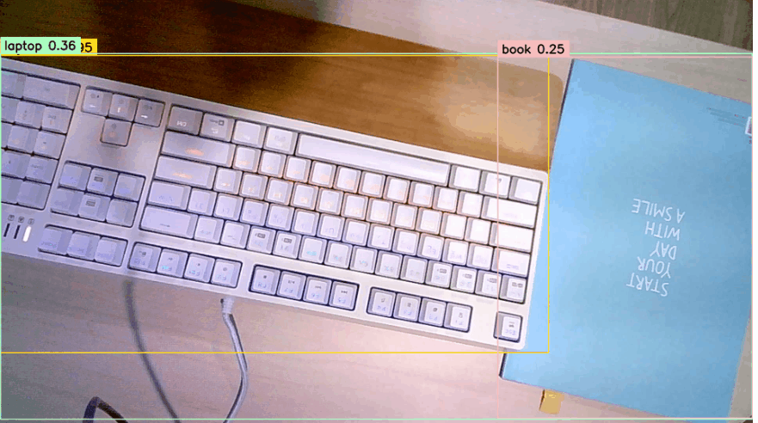
Problems
Low FPS
Render total page
Notes:
이 앞에 앱 시연
However, after running this local app, there were some problems. First, due to the lack of processing ability of the local pc, the frame decreased when image recognition was performed. And the flexibility of the front page was reduced by rendering the entire page from the local through flask.

Slide 31
Error & Trial
Low FPS
Set Webcam & Get Detection
Get Parameter & Form Dynamic Page
Communication between Colab Server and Front-End
Run on Colab
Use Flask
Use React.js
Use ngrok
Notes:
We are currently in the process of trial and error with the goal of solving these problems and using the Colab server to run. So left side is error and right side is our trial.

Slide 32
Future Works

Slide 33
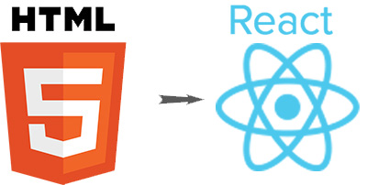
Front End → React.js
Notes:
We made front page by Vanilla javascript and html. We convert front end to react.

Slide 34
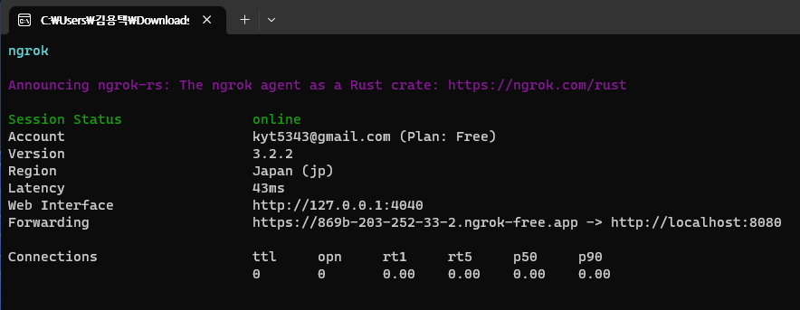
Local Program(Html) → External Server
By Using Ngrok
Notes:
As we said before, we are going to use Server and client way, not the local program.
So from this week to final, we will try to connect our local application to external server, so that client can simply connect to the web page.
We are going to use Ngrok program, as you can see it converts local page to external server.

Slide 35
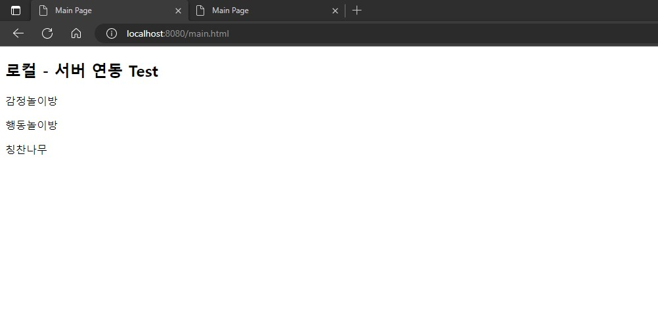
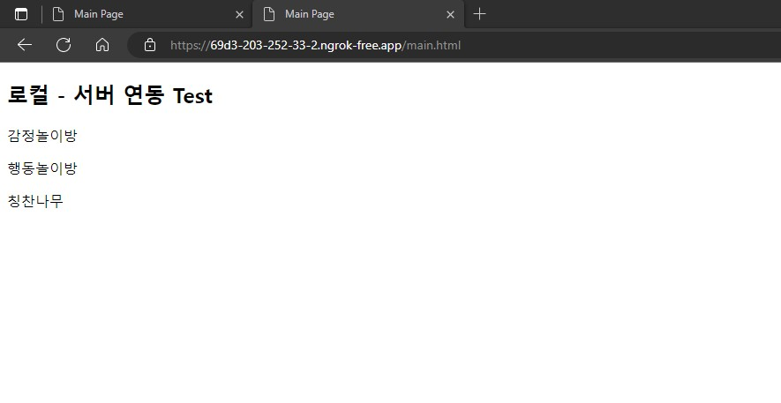
Local Program(Html) → External Server
Notes:
So as you can see in the address window, Ngrok converted local html file to external server.

Slide 36
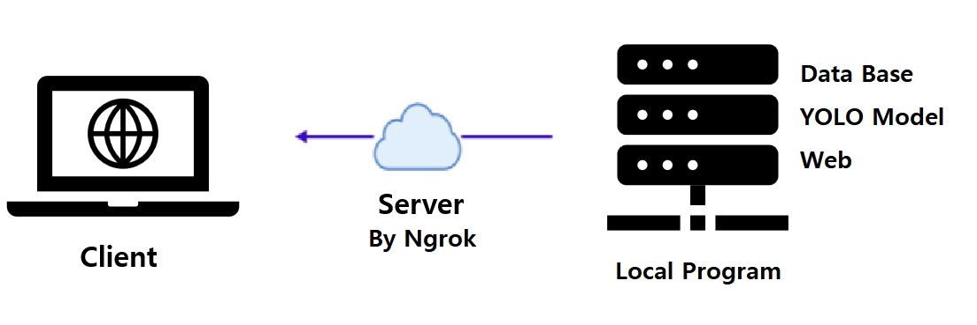
Local Program(Html) → External Server
<Check Point>
Latency (For Real Time Webcam Detection..)
Multiple Access
Notes:
This shows our vision map.
And we will check about latency for real time webcam, and multiple access at the same time.

